Slide 1
System Concepts:
Definition of a System
Characteristics Of System
Elements Of The System
Types Of The System
The Systems View and Systems Thinking
Subsystems
Organizational Efficiency And Effectiveness

Slide 2
Introduction
The term ‘system’ is a commonly used word. One speaks of an educational system, computer system, system of theology, and many others.
An information system is, as its name implies, a special type of system. System theory (or concept) provides a useful framework for describing and understanding many organizational phenomena including features of information systems and how they may be analyzed and designed

Slide 3
What is system?
The word system is derived from the Greek word “systema” which means the organized relationship among the functioning units.
However, the word system always comes with an adjective, whenever we talk about a system such as educational system, political system, accounting system etc.
But if we carefully analyze these systems, we can find that there are some features common to all the systems.
These are the characteristics of the system which help us to understand the working definition of the word system.

Slide 4
Definition of a System.
Since a system is a subjective concept, there is no unanimously accepted definition of a system. In order to study this phenomenon more closely, we can start by adopting the following definition:
A system is an organized assembly of components with special relationships between the components.
A system is an orderly grouping of independent components linked together according to plan to achieve a specific objective.
The system does something, i.e. it exhibits a type of behaviour unique to the system or has a specific objective or purpose.
Each component contributes specifically towards the behaviour of the system and is affected by being in the system. If a component is removed, it will change the system behaviour.
Someone has identified the system as being of special interest.

Slide 5
CHARACTERISTICS OF SYSTEM
The characteristics of the system are
1. Basic components
2. Interaction and structure
3. Goal
4. Behavior
5. Life cycle

Slide 6
1. Basic components
As per the definition of system, the functioning units means the basic elements of the system which are interrelated. These are the basic components of the system.
So, these basic elements are nothing but the identifiable and moving parts of the system.
Following are some examples of system and its basic components.
I. Educational system: Students, teachers, books, computers.
II. Computer system: Monitor, CPU, keyboard.

Slide 7
Interaction and structure
An important feature of the system is the basic components must interact among themselves.
It is not only collection or grouping of elements. If an organization is considered as a system, then purchase department must interact with stores and production department, production with Inventory and so on. Also, they are interdependent on each other.
This interrelation activity of the components makes the system dynamic.
Such a relationship among the components which define the boundary between the system and environment is known as the structure of the system

Slide 8
Goal
In order to achieve the goal of the system we should first understand the meaning of
I. Central objective
II. Integration
III. Synergistic effect
I. Central Objective : Central objective means the common goal, because without a common goal, a system will start moving in all directions. As a result, coordination among all the parts (Components) will be lost.
II. Integration: This is combined work of all the components in order to achieve the goal of the system. There must be coordination among all parts of the system.
So, in order to have such coordination the system must work as a ‘whole’, integrating all its activities to achieve the desired result.

Slide 9
III. Synergistic effect: From the integration concept it is clear that the system has to be viewed as ‘whole’ rather than just as sum of its parts. This integrating effect is called as synergistic effect.

Slide 10
4. Behavior:
Behavior is the way the system reacts to its surrounding environment.
Behavior is determined by the procedures designed to make sure that components behave in ways that will allow system to achieve common goal.
For example: If we touch an object which is hot, the nervous system makes our body to withdraw immediately from the hot source.
So, heat is input from environment, reaction is the behavior and instruction in the nervous system (how to react) is the procedure.
Procedure describes what ought to be done and behavior describes what is actually done.

Slide 11
5. Life cycle:
Every system has life cycle and according to human life it has birth that is evolution, life, aging, repairs and finally the end of the existence of the system (death).
So, finally we can define system as follows.
A System is an integrated collection of the components which satisfy functions necessary to achieve the system goals and which have relationship to one another that defines structure of the system.

Slide 12
1.3 ELEMENTS OF THE SYSTEM
All the characteristics of the system are determined by the system elements, their properties and relationships. The system elements are
1. Input
2. Processor
3. Output
These elements are common to all systems. These are the elements by which all systems are described. They are set in a fixed position which helps the system analyst to design & work with system more easily.

Slide 13
1. Input: It is defined as energizing or the start up component on which system operates. It may be raw material, data, physical source, knowledge or any energy to decide the nature of output.
2. Processor: It is defined as the activity that makes possible the transformation of input to output. When data is processed through computer it is processed through logical steps. However, these steps are required to be instructed in series to the computer.
3. Output: It is the end result of the operation. In other words, it is the purpose or the main objective for which the system is designed. Though output is largely dependent on input, its nature or format may vary vastly from the input. For example: If data keyed is in numerical form it may display output which is in form of graph or pictorial form.

Slide 14
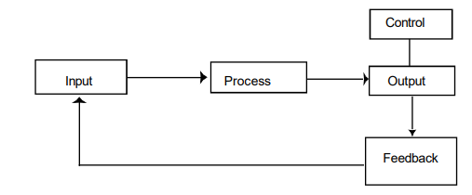
Following model represents a system with its elements which keeps the system in equilibrium.

Slide 15
In order to build any system only the knowledge of its elements does not serve the purpose, there should be fundamental clarity of some important concepts which are essential to build the efficient system & to keep it in equilibrium.
The major concepts are
Boundary & environment
II. Subsystem
III. Interface
IV. Feedback control
V. Black box

Slide 16
Boundary & environment:
Every system has its limits that determine the sphere of influence & control. This is called the Boundary of the system. Everything within the circumscribed space is called system & everything outside it is the environment. Flow from environment to the system is its input while a flow from system to its environment is the output.
So, as soon as we identify a system, we define a boundary: what is inside the boundary belongs to the system, everything outside the boundary is not part of the system. However, most systems do not exist in isolation. Systems, or their components, interact with the world outside their boundary. The part of the outside world with which the system interacts is called the system’s environment.
Boundary of the system may exist physically or conceptually.

Slide 17
II. Subsystem:
A complex system is difficult to implement when consider as a whole. However, if we divide it into smaller functional units which are of manageable sizes then every small function unit becomes a subsystem.
The subsystems resulting from this process generally form hierarchical structures. In the hierarchy, a subsystem is one element of a suprasystem (the system above it). In the formation of subsystems, the components performing same or similar functions are grouped. For example: In a business organization system, marketing, production, sales can be considered as subsystems.

Slide 18
Module: A collection of function or data. In other words, module encapsulates related functions. Ideal module is that module which can be reused in other development projects.
The general principle in decomposition which assumes that system objectives dictate the process is functional cohesion. Components are considered to be part of the same subsystem if they perform or are related to the same function
The level of detail with which you study a given system is called the granularity

Slide 19
III. Interface: The interconnections & interactions among the subsystems are termed as interfaces. In fact each interface implies a communication path. Number of interfaces increase with number of subsystems.
IV. Feedback control: In order to improve the performance of any system feedback control mechanism can be used as a tool or device to control or modify the input of the system after analyzing the output properly.

Slide 20
Control is the mechanism whereby the system is able to modify the processes and activities (behaviour).
This ‘round trip’ of using output signals and using them to modify input signals is called a feedback loop, and the whole process is one of feedback control.
There is always a slight delay before the output can be “interpreted”, the consequent control changes are effected and the system behaviour is adjusted. This delay is called the (time) lag.

Slide 21
IV. Black box: Black box is the subsystems at lowest level where the inputs are defined, outputs are determined but the processor of the system is not defined making it difficult to understand how the transformation of input to output takes place.

Slide 22
TYPES OF THE SYSTEM
We will have comparative study of different types of system.
1 Conceptual & Physical system
1. Conceptual (abstract) system is an orderly arrangement of independent ideas. For example: Economic theory, Theory of relativity.
2. Physical system: These are the concrete operational systems made up of people, material, machines energy & other physical things. For example: Management information system.
Physical systems being operational systems can display activities or behavior. While conceptual system works on different ideas or concepts and displays theoretical structures.

Slide 23
2. Closed and Open Systems
A closed system is defined in physics as a system which is self-contained. It does not exchange material, information or energy with its environment. An example is a chemical reaction in a sealed, insulated container. Such closed systems will finally run down or become disorganized. This movement to disorder is termed an increase in entropy
In organizations and information processing, there are systems that are relatively isolated from the environment but not completely closed in the physics sense. These will be called closed systems, meaning relatively closed.

Slide 24
Open systems can be said to be those systems which interacts with its environment. For example: Any business organization system exchanges its material, manpower, money & information with its environment.
And Closed systems are those systems which do not interact with its environment. It has only controlled & well-defined input & output. For example: Television is itself is closed system which controls its sharpness, brightness automatically with sensors

Slide 25
3. Deterministic and Probabilistic Systems
A deterministic system operates in a predictable manner. The interaction among the parts is known with certainty. If one has a description of the state of the system at a given point in time plus a description of its operation, the next stage of the system may be given exactly without error. E.g. Computer system.
The probabilistic system can be described in terms of probable behaviour, but a certain degree of error is always attached to the prediction of what the system will do. E.g. Inventory replenishment system, Weather forecasting system.

Slide 26
4. Natural & Artificial systems
1. Natural systems: All the naturally occurring systems are called as natural systems For example: Solar system.
2. Artificial system: All man-made systems are called as artificial systems.
5. Integrated system
System integration is the combination of related subsystems to form a larger subsystem or total system. For example: Airline reservation system

Slide 27
6. Dynamic vs Static Systems
A dynamic system is a system that has at least one (and usually many) activity or process; as opposed to a static system, which has no activity, whatsoever
7. Continuous vs Discrete Systems
A continuous system is a system where inputs (and outputs) can be varied by extremely small amounts or quantities.
Discrete systems are systems where the inputs or outputs can take on only certain discrete or distinct values.

Slide 28
The Systems View and Systems Thinking
The definition of a system is, however, somewhat of an academic exercise. The real essence of systems theory is being able to look at the world from a different perspective.
The systems view involves adopting the reference framework and the terminology of systems theory, trying to apply various analogies with other systems and checking which of the systems laws and theories hold for the system of interest.

Slide 29
Why is this systems view so important?
Can we not just learn about the technology of information systems and dispense with more philosophical matters?
The problem with the purely technical approach is that it often fails to take into account the inter-relation of problems and proposed solutions, which is incorporated in the systems view

Slide 30
Structure and Hierarchy
The interactions between the various sub-systems and components of a system display some pattern or regularity. In this sense the observer can identify certain relationships, which contribute to the overall behaviour of the system. The entire set of relationships is referred to as the structure of the system.
Smaller sub-systems are thus embedded within the system, which in turn may be a sub-system of yet another, larger system: the supra-system. This nesting of systems within systems within systems is referred to as a system hierarchy

Slide 31
Holism and Emergent Properties
The perspective which claims that many aspects of a system can be understood only in terms of its entirety, and not necessarily be reduced to the characteristics of its components, is called holism (the opposite of reductionism).
This is often expressed in the popular saying that a system is more than the sum of its parts.
Holism also implies that it is important to be aware of the inter-relation between the various components of a system.

Slide 32
The holistic systems view implies that a system has certain properties, qualities or attributes which cannot be reduced to or understood from its components alone. These properties are called the emergent properties of a system.

Slide 33
Entropy
An important measure of a system is the amount of order (in the case of matter or information) or potential energy it contains.
The measure for disorder or energy degradation is entropy: the higher the level of disorder, the higher the entropy level.
All systems change over time and, unless a system can draw on resources from the environment, it will tend to become more disorderly or lose energy (“run down”) i.e. entropy increases.

Slide 34
Organizational Efficiency And Effectiveness
Systems concepts suggest two major classes of performance measurement: Effectiveness and Efficiency.
Effectiveness is a measure of actual output against desired output. It represents the reason the system exists. It is a measure of the extent to which a system achieves its goals and can be computed by dividing the goals actually achieved by the total of the stated goals

Slide 35
Efficiency is a measure of the relative cost of producing output. It is the use of inputs to produce output. It is a measure of what is produced divided by what is consumed.
Organizations tend to measure and control efficiency more than effectiveness.
The reason is that efficiency measurements tend to be easier to obtain and more precise in formulation often leading to the production of wrong output efficiently.

Slide 36
Information system development for applications may be measured by adherence to budget and development standards (efficiency) with no attention to how well the application meets the needs of the customers (effectiveness).
A word processing centre monitors keystrokes, errors, and lines produced (efficiency) but not whether the documents produced have higher quality than typewritten documents (effectiveness).

Slide 37
Organizations as Systems
Let’s use a business organization to illustrate the fundamental components of a system, as well as several other system characteristics.
In the next diagram, the system exchanges inputs and outputs with its environment.
Thus, we could say that it is connected to its environment by input and output interfaces.
Finally, a system that has the ability to change itself or its environment to survive is an adaptive system.

Slide 38
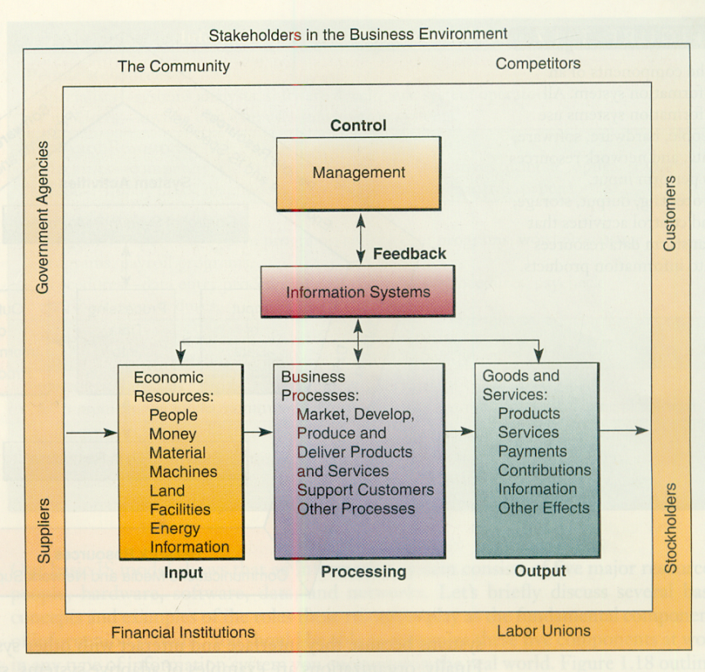

Slide 39
A system does not exist in a vacuum; rather, it exists and functions in an environment containing other systems.
If a system is one of the components of a larger system, it is a subsystem, and the larger system is its environment.
Some of these systems may be connected to one another by means of a shared boundary, or interface.

Slide 40
A business is an example of an organizational system in which economic resources (input) are transformed by various business processes (processing) into goods and services (output).
Information systems provide information (feedback) about the operations of the system to management for the direction and maintenance of the system (control) as it exchanges inputs and outputs with its environment.

Slide 41
If we apply our understanding of general system concepts to information systems, it should be easy to see the parallels.
Information systems are made up of interrelated components:
People, hardware, software, peripherals, and networks.
These have clearly defined boundaries:
Functions, modules, type of application, department, or end-user group.:
All the interrelated components work together to achieve a common goal by accepting inputs and producing outputs in an organized transformation process:

Slide 42
• Using raw materials, hiring new people, manufacturing products for sale, and disseminating information to others.
Information systems make extensive use of feedback and control to improve their effectiveness: Error messages, dialog boxes, passwords, and user rights management.
Many information systems are designed to change in relation to their environments and are adaptive: They include:
Intelligent software agents, expert systems, and highly specialized decision support systems.
Information systems are systems just like any other system. Their value to the modern organization, however, is unlike any other system ever created.

